Slide 1
Bank Loan Project

Slide 2
Loan details: The dataset contains key information such as loan amounts, interest rates, terms, and installments for various loans. Borrower information: Includes member ids, verification status, and loan purpose (e.g., debt consolidation, credit card payoff). Loan grades: Each loan is categorized into grades and sub-grades, reflecting the borrower's credit risk. Payment status: Contains data on loan statuses (e.g., fully paid), along with zip codes and state information of the borrowers. Issue date: The dataset includes loan issuance dates, providing a timeline of when loans were granted.
Introduction

Slide 3
Objective: Analyze key KPIs like year-wise loan amounts, grade-wise revolving balances, and payments by verification status to understand loan performance. Key insights: The analysis reveals trends in loan issuance, payment patterns across different verification statuses, and the impact of homeownership on repayment behavior. Techniques: Aggregation, grouping, and joins were used in sql queries to summarize the data for actionable insights. SAM model: S for storing data: efficiently store bank loan data in structured databases. A for analyzing data: use SQL queries to extract and interpret key insights. M for modifying data: clean and modify data for better analysis and reporting.
SQL syntax and key highlights

Slide 4
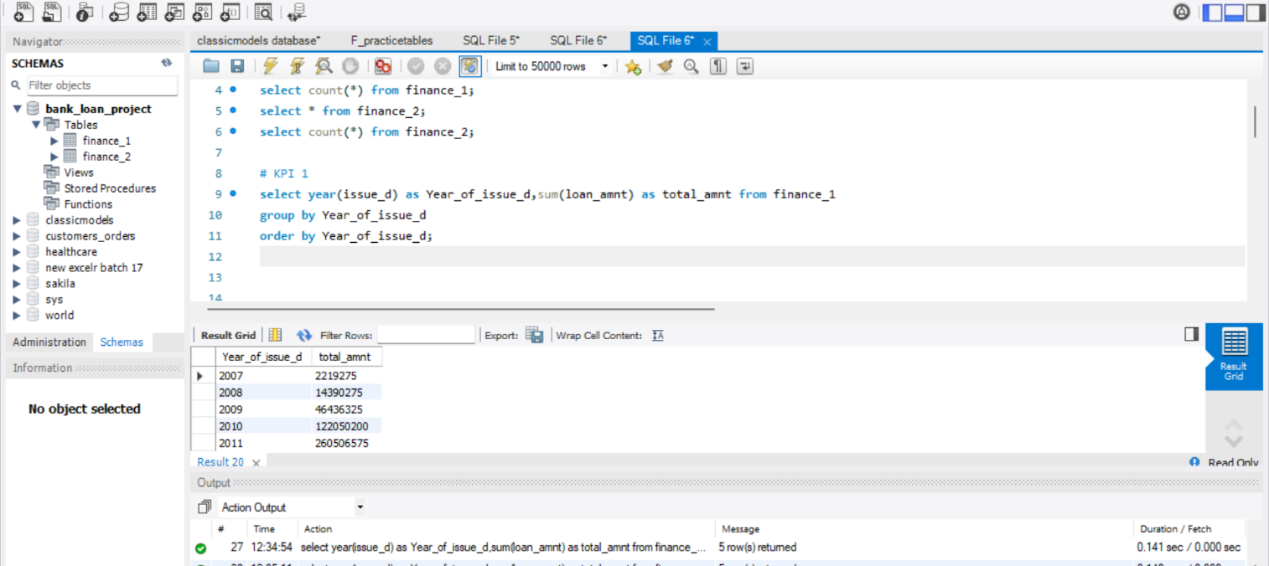
Year wise loan amount stats

Slide 5
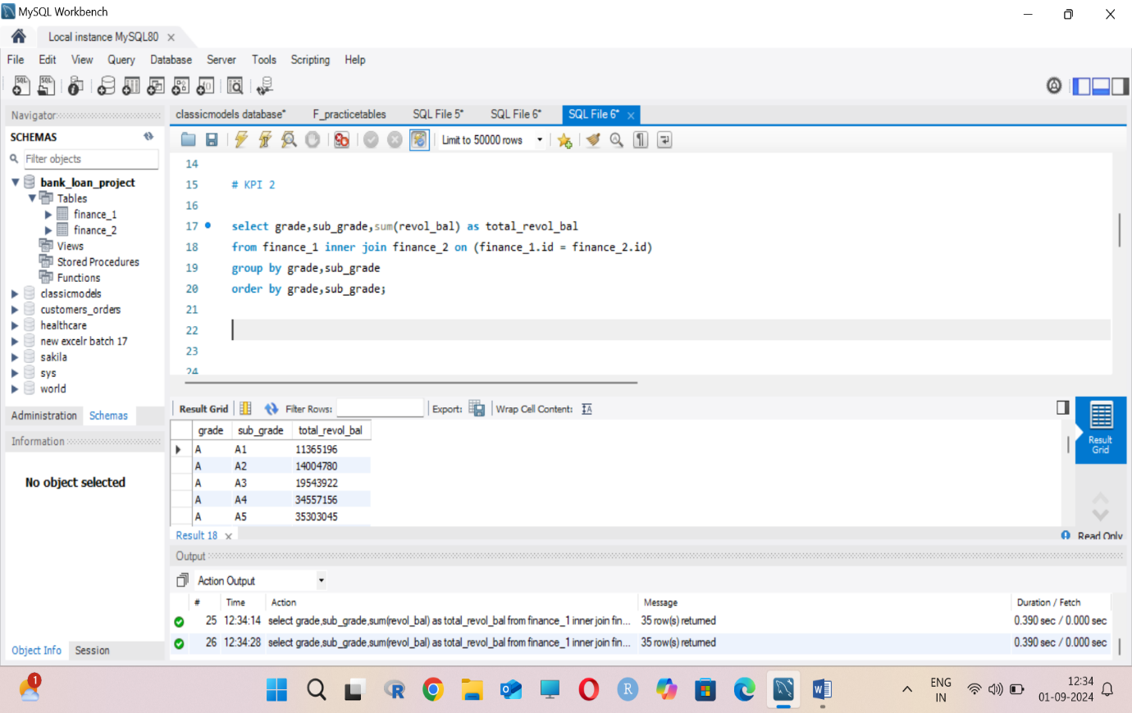
Grade and subgrade wise Revol_bal

Slide 6
Loan Distribution by Amount and Term: The dashboard provides a breakdown of loans by the amount issued and loan terms (e.g., 36 months), highlighting the most common loan structures. Interest Rate Analysis: It showcases how interest rates vary across different loan grades and sub-grades, providing insights into credit risk and pricing strategies. Geographical Insights: The dashboard includes data on borrower locations (zip codes and states), offering a view of regional lending patterns and trends. Loan Purpose and Status: Insights into loan purposes, such as debt consolidation and credit card payoff, along with loan statuses (e.g., fully paid), help understand repayment success and loan usage. Verification Status Impact: The data highlights differences in loan performance based on verification status, giving a clear view of risk management and borrower reliability.
Excel Dashboard

Slide 7
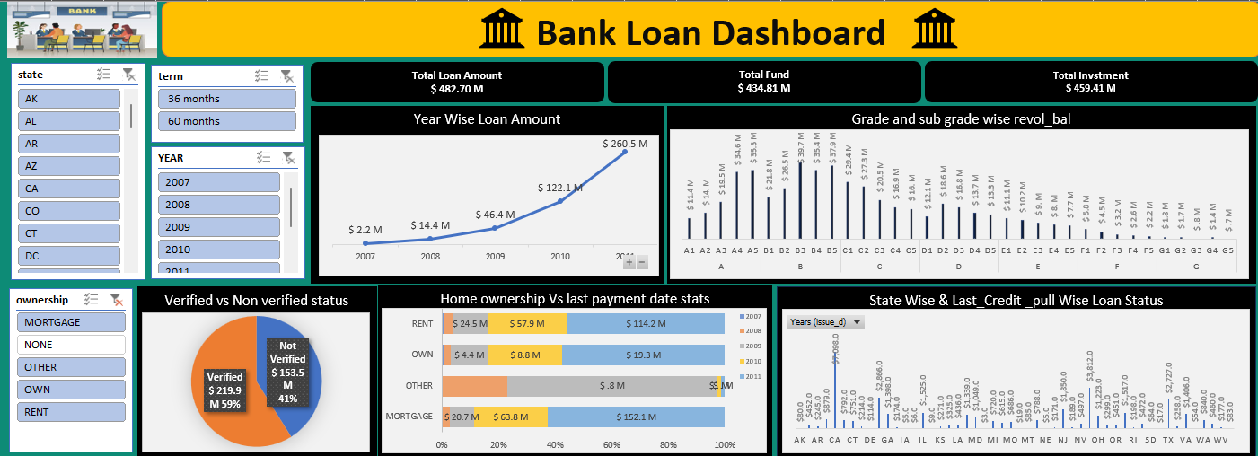

Slide 8
Power BI Dashboard
Total Loan Amounts: Highlight the significant figures displayed, such as the total loan amounts of 446M and 373M. Explain what these figures represent and their importance in your analysis.
Average Interest Rate Trends: Discuss the average interest rate of 12.02% and use the trend line graph to show how interest rates have fluctuated over time. This can help illustrate the financial environment and its impact on loans.
State-wise Loan Distribution: Use the bar chart to explain the distribution of loans across different states. Point out any notable trends or outliers and discuss potential reasons for these variations.
Loan Status Over Time: Analyze the line graph that tracks loan statuses over time, such as ‘Current’ versus ‘Fully Paid.’ Highlight any significant trends or changes and their implications for the bank’s loan portfolio.

Slide 9
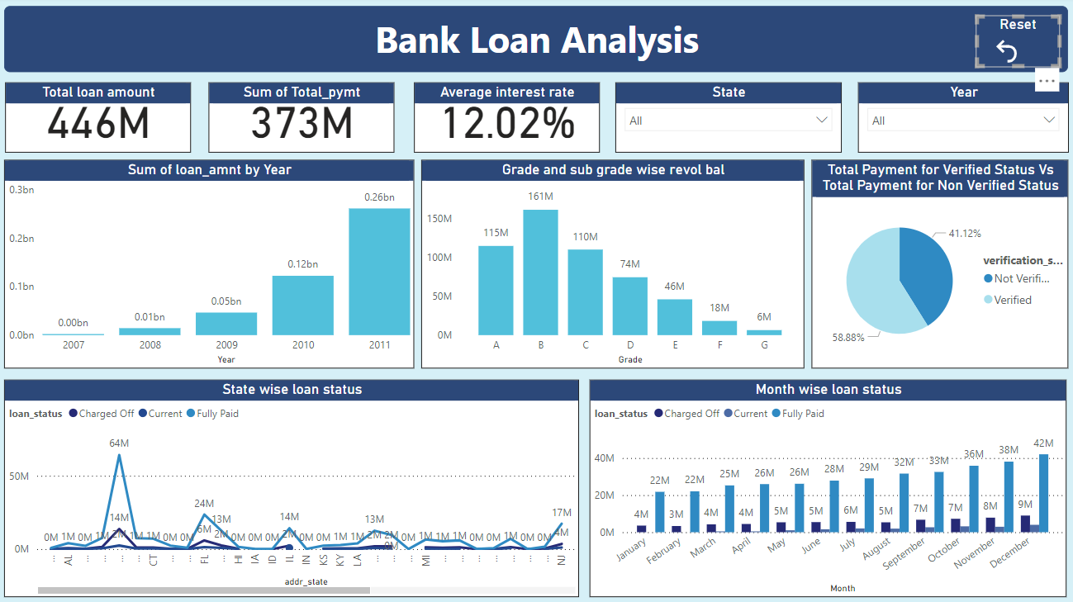

Slide 10
Tableau Dashboard
Loan Balances by Grade: Highlight the distribution of revolving balances across different loan grades and subgrades, as shown in the bar graph. Discuss any significant differences and what they might indicate about loan performance.
Year-over-Year Loan Amount Trends: Use the area chart to explain the changes in loan amounts over the years. Point out any notable trends or patterns and their potential implications for future lending strategies.
Verification Status Comparison: Present the pie chart data to compare the proportions of verified versus non-verified loans. Emphasize the importance of loan verification and its impact on loan quality and risk management
Geographic Loan Distribution: Analyze the bar graph showing loan status by state and last credit
pull. Discuss any regional trends or outliers and what they might mean for the bank’s regional strategies.

Slide 11
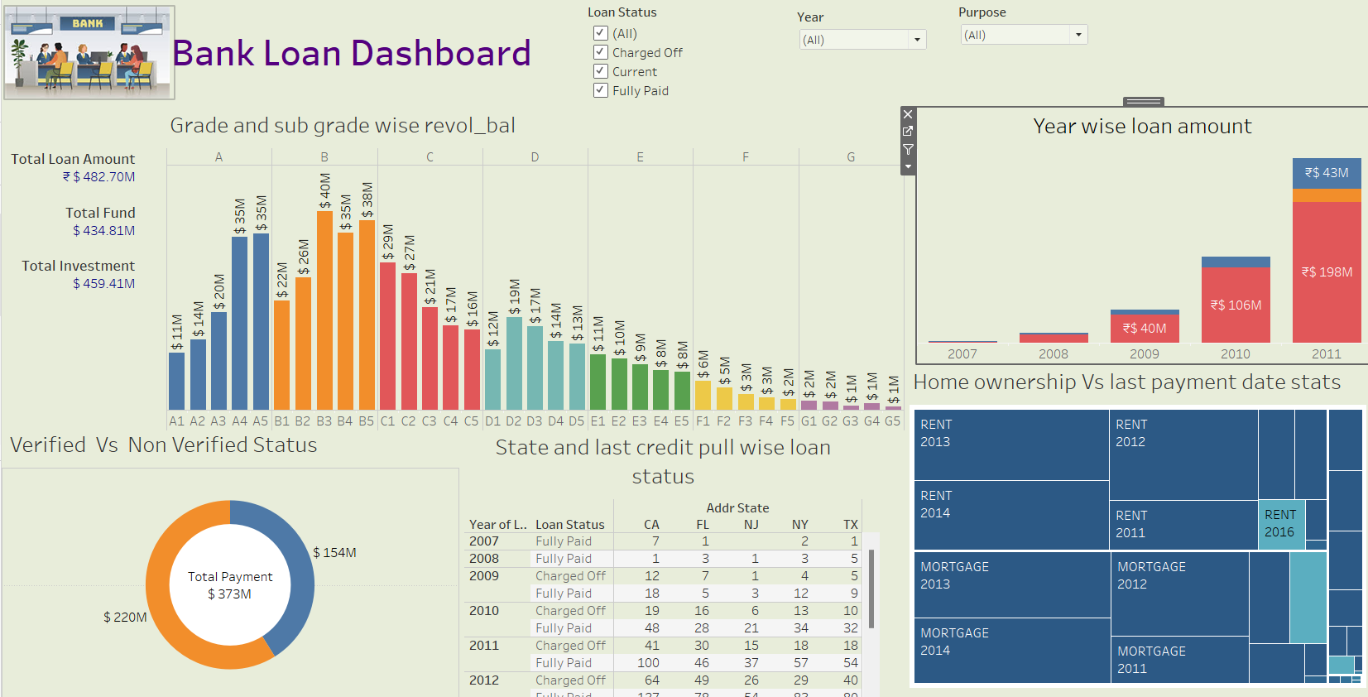

Slide 12
1. Based on the analysis of the dataset, debt consolidation emerges as the primary reason for borrowing, followed by credit card payoffs, showing that borrowers often use loans to manage existing debts. 2. The interest rates are aligned with the loan grades, where lower-grade loans come with higher interest rates, indicating a higher risk for lenders. Fully paid loans dominate the dataset, which suggests a strong repayment trend among borrowers. 3. The data also highlights regional borrowing patterns, with states like California and New York showing higher loan activity. Lastly, loans that are verified tend to perform better, underlining the importance of verification in improving loan outcomes.
Conclusion

Slide 13
Suggestions to the Company to improve performance
Enhance Borrower Verification: Focus on increasing the percentage of verified loans as these have better repayment rates, reducing defaults and improving overall loan performance.
Target High-Risk Borrowers: Implement stricter credit assessments and higher interest rates for lower-grade borrowers to compensate for the increased risk, while offering tailored repayment plans.
Expand Geographic Focus: Analyze underrepresented regions and expand lending in states with fewer loans but high potential, diversifying the loan portfolio geographically.
Promote Debt Consolidation: Since debt consolidation is the most common loan purpose, consider offering incentives or special packages for borrowers consolidating high-interest debts.
Optimize Loan Terms: Explore offering more flexible loan terms beyond the common 36-month period to meet a wider range of borrower needs and improve repayment convenience.
Data-Driven Marketing: Use the insights from borrower profiles, such as loan purposes and repayment behaviors, to design targeted marketing campaigns that attract reliable borrowers and reduce churn.

Slide 14
THANK YOU

